Slide 1

DriverPass System Analysis
Tevaen Kenerly
Notes:
Good evening DriverPass, my name is Tevaen Kenerly and today I will be presenting to you the system analysis of the DriverPass system. We have taken the time to fully go over the design and system requirements for this system. With the business requirements and initial meetings behind us, we are ready to move forward with this project as we present to you our system analysis.

Slide 2

System Requirements
Nonfunctional requirements
Runs over the cloud
Database
Functional requirements
Registration system
User account management
Notes:
When designing a system like DriverPass we think of two types of requirements, these are nonfunctional and functional requirements. Functional requirements are things the system needs to do such as the actual task or features. These are needed because they describe how the system behaves and what the users can expect to interact with. Nonfunctional requirements are things the system needs to be such as qualities that make it work well. They make sure the system is reliable, secure, and user friendly. We made a whole list of these two requirements to make sure we implement the right things into the system based off your business requirements. For this I will explain these 4 to you.
Two of the nonfunctional requirements for the DriverPass system design that we will implement into the system is a database and a cloud-based system. By implementing this database into the system this will allow for the user's data to be saved such as login information, test information such as; status, test taken, scores, times, comments, etc. It will also allow for reservation information to be saved and any other personal information. The database is essential for this system to operate to the company's standards as it ensures for easy accessibility for the students, instructors, drivers, administrators, and anyone else who is involved in the system. The second nonfunctional requirement that I will be talking about is running the system over the cloud. Running the system over the cloud ensures scalability and accessibility. This allows the system to easily handle growing numbers of students and reservations, which will help in the expansion to new regions. It will allow for students, secretaries, and IT admins to access the system from any device, anywhere, anytime. This helps the company meet its goal with mobile and browser-based access. This will also help support DMV updates and notifications. Running the system over the cloud will also support disaster recover and reliability as backups protect the system from data loss. Cloud providers also offer built-in encryption, firewalls, and monitoring tools which will help the company with security for the system, as it protect sensitive information like credit card details and personal data.
Now for the functional requirements for the DriverPass system. The registration system will support the students in training for driving test, offer packages, provide online and on the road training. The registration system will capture the user's data such as name, address, phone number, payment information, and more. It provides the students with the option for online or on the phone-based registration, which helps increase accessibility. The user account management system will hold each user's unique details. It will enable secure login and password resets. It will allow for role-based access, that way your students, secretary, IT admins, and drivers all get a tailored interface suited for their useability. It will provide lesson progress, test scores, and driver notes and comments. It will allow for activity reports for the admins and instructors. It will allow you to block access or modify accounts if needed. All together these are 4 requirements that will play a huge role in your system that we implemented into the system.

Slide 3
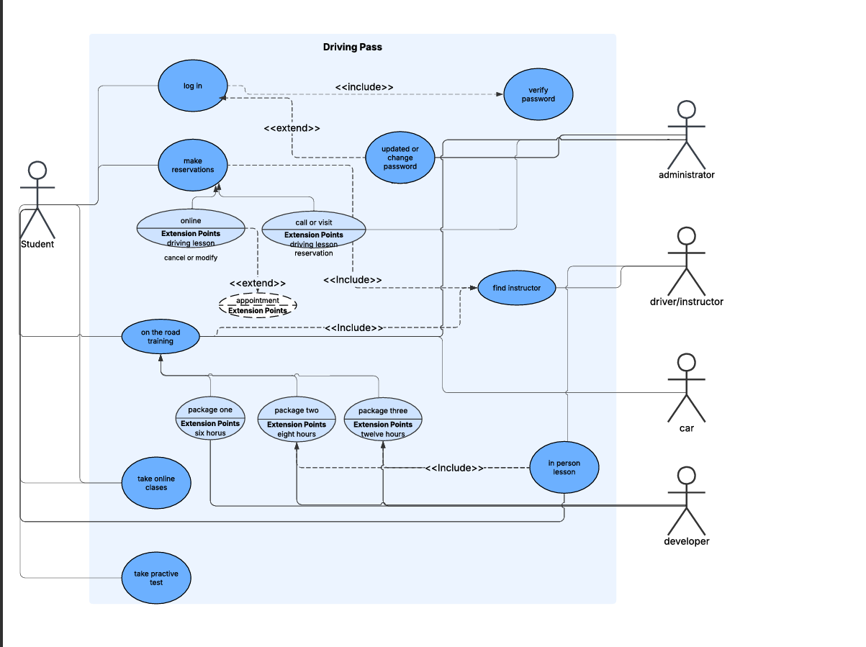
Use Case Diagram
Notes:
This is a use case diagram; this diagram is used to show some of the important functions of the system. This diagram explains what each person who will interact with the system or use the system in some way will be able to access or interact with. We make these diagrams to visually show how people will interact with a system and what they can do and how the system responds. It's like drawing a map of the systems features from the user's perspective.
Let's start off with the developer, the developer needed to be able to access on the road training to edit and update packages since the IT admin will not have access to this. Because of that we have the developer in this diagram as it shows that they are able to interact with on the road training. We also have the administrator, the administrator is able to access and modify things such as the login part of the system, as they can change passwords, answer phone calls, see the reservations, and access the on the road training packages. Next, we have the student, who is able to find instructors. The student also will be able to log in, update or change their passwords, make reservations, have in-person lessons, go to the on the road section, view the packages, take online classes, take practice test and have in person lessons. We also have the vehicle on this diagram as a part in the systems operation, since it is affected by it in some way. The car is needed in order to offer the on the road training. Lastly, we have the driver or instructor. They need to be able to see the reservations, see the on the road training and who is selecting the packages, be notified if they are selected as an instructor for in person training or on the road training, as well as seeing if anyone cancels or modifies appointments. These are the specific features each person or thing that will have a role in this system will be able to do.

Slide 4
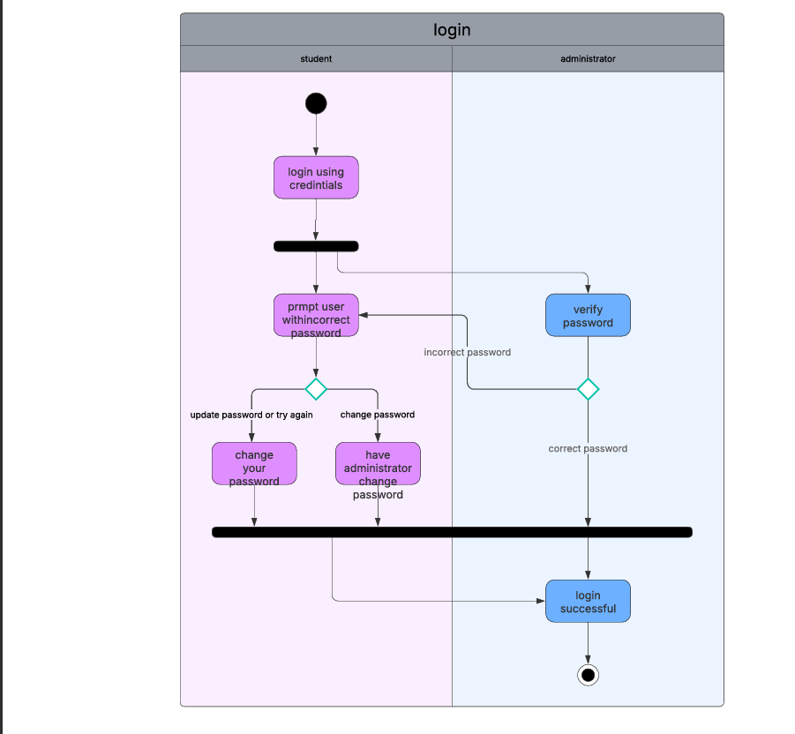
Activity Diagram
Notes:
This is an activity diagram; these are used to visualize the flow of the processes that are in a system. We make activity diagrams to show how a process works step-by-step. This is focused on actions and decisions in a system.
For this one that I will be showing you, it will specifically show you the process of the login. The first step in this shows that you are prompted to login with your credentials. Next, your password will go through a verification, if it is successful the login is complete. Now, if the login is unsuccessful, it will prompt you with incorrect password. This will give you the option to either try again/change password. Now you will have two options, you can change your own password or have the administrator change the password for you. After this it will then log you in as you were requested to have your password changed. With this we accounted for DriverPasses needs by providing a password verification system. This system also allows the administrator to change the password as well.

Slide 5
Security
cloud based
Database
Authentication modules
Encryption system
Firewall
Payment gateway
Notes:
These are some of the security features that we implemented into the system. Security was a top priority in designing the DriverPass system. Because security handles personal information such as names, addresses, payment details, etc. We made sure to include strong protections to keep that data safe. First, the system runs on the cloud, which means its hosted in a secure online environment that’s monitored and backed up regularly. We also used a secure database to store user information, so everything is organized and protected. To make sure only the right people can access the system, we added login features that check for user identity and password verifications. If someone forgets their password, they can reset it safely, and IT staff can help if needed. We also included tools that keep track of who's making changes in the system, that way nothing goes unnoticed. When users pay for packages, their payment information is handled through a trusted payment service, which keeps financial data secure. To protect the system from hackers or unwanted access, we added digital barriers and defense, think of these like locks on your doors. We designed DriverPass to be secure, reliable, and respectful of user's privacy, so students and staff can focus on learning and teaching without worrying about their private information.

Slide 6
System Limitations
Data redundancy
Limited technical infrastructure
Budget
Resources
Notes:
Now, with all of the great things about this system that we have designed for you, this does come with some limitations. We make system limitations presentable to you in order to fully understand where we are limited at for development. To start off we have data redundancy. This means the system may store the same information in multiple places. This can lead to confusion, wasted space, and errors if updates are not synced properly. Next, we have limited technical infrastructure. If the system relies heavily on the cloud services but doesn’t have strong local support, it may struggle during outages or high traffic. Next, we have budget. With a limited budget, it may be difficult to afford advanced features like automated scheduling, real-time DMV updates, or top-tier security tools. Lastly, we have resources. With fewer developers, analyst, support staff, IT admin, or support staff in general, this means slower updates, less testing, and fewer improvements overtime. It can also limit how quickly bugs are solved.
Now, these limitations don’t mean the system wont work. They just highlight areas to watch and improve as the project grows. We will keep this in mind going forward but for now the system is ready to kick off!

